Slide 1
5 Types of Chemical Reactions
Unit 4
Chapter 10

Slide 2
1. Combustion Reactions
Occurs when oxygen reacts with a hydrocarbon to produce water and carbon dioxide.
A hydrocarbon is a compound containing only Carbon, Hydrogen and sometimes oxygen.
Example:
C₁₀H₈(s) + 12O₂ (g) → 10CO₂ (g) + 4H₂O(g)

Slide 3

2. Synthesis (or Combination)
the combination of 2 or more substances to form a compound
only one product
A + B → AB
Example: 2 Cu + O₂ → 2CuO

Slide 4
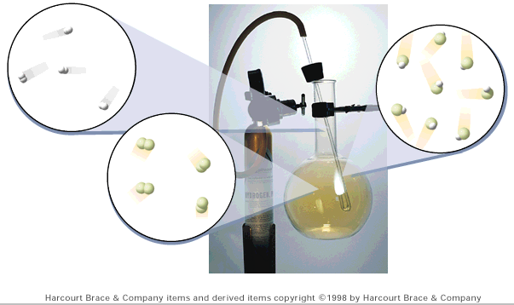
Synthesis
H₂(g) + Cl₂(g) → 2 HCl(g)

Slide 5

3. Decomposition
a compound breaks down into 2 or more simpler substances
only one reactant
Examples:
2H₂O(l) → 2H₂(g) + O₂ (g)
H₂CO₃ (aq) → H₂O (l) + CO₂ (g)
AB → A + B

Slide 6
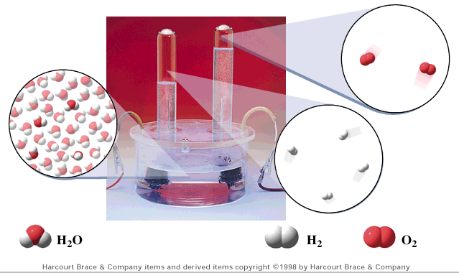
Decomposition
2 H₂O(l) → 2 H₂(g) + O₂(g)

Slide 7

3. Single Displacement
Occurs when a single element reacts with an ionic compound and switches places with one of the elements in the compound.
A + BC → B + AC

Slide 8
4. Single Displacement
General Form: AB + C → AC + B
Cation Displacement
Al + CuCl₂ (aq) → Cu + AlCl₃(aq)
Anion Displacement
Cl₂ + KBr → KCl + Br₂

Slide 9
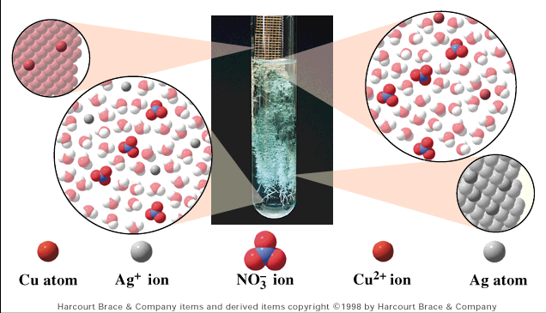
Single Displacement
Cu(s) + 2AgNO₃(aq) → Cu(NO₃)₂(aq) + 2Ag(s)

Slide 10

5. Double Displacement
ions in two compounds “change partners”
cation of one compound combines with anion of the other
AB + CD → AD + CB

Slide 11
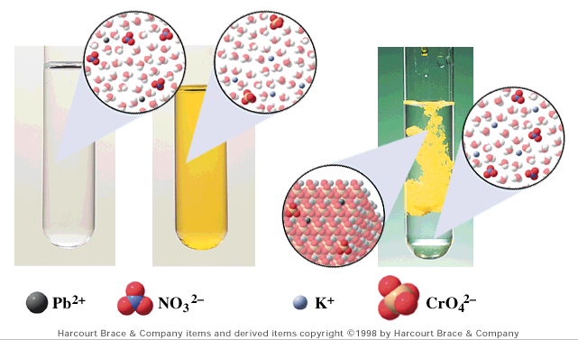
Double Displacement
Pb(NO₃)₂(aq) + K₂CrO₄(aq) → PbCrO₄(s) + 2KNO₃(aq)
Usually produce a solid product (precipitate)!

Slide 12
Steps to Classifying Reactions
1. Does the reaction contain oxygen, carbon dioxide and water? If Yes, then it is combustion
Do simple molecules form one more complicated product? If yes, then it is synthesis/combination.
3. Does a single reactant break apart to 2 or more simpler products? Then it is decomposition

Slide 13
Steps to Classifying Reactions
Continued. . . .
4. Is there an ionic compound and a single element on the reactant side and product side? Then it is single displacement.
5. Are all compounds ionic? Then it is double displacement.

Slide 14
Examples
C₃H₇OH + O₂ → CO₂ + H₂O
Mg + O₂ → MgO
H₂O₂ → H₂O + O₂
Al + CuCl₂ → Cu + AlCl₃
Pb(NO₃)₂ + KI → PbI₂ + KNO₃
Combustion
Synthesis
Decomposition
Single Displacement
Double Displacement
MgO

